Slide 1
The Three Little Pigs

Slide 2
The three little pigs are jolly and happy. They like to play football. But soon it is cold autumn. They need houses.

Slide 3
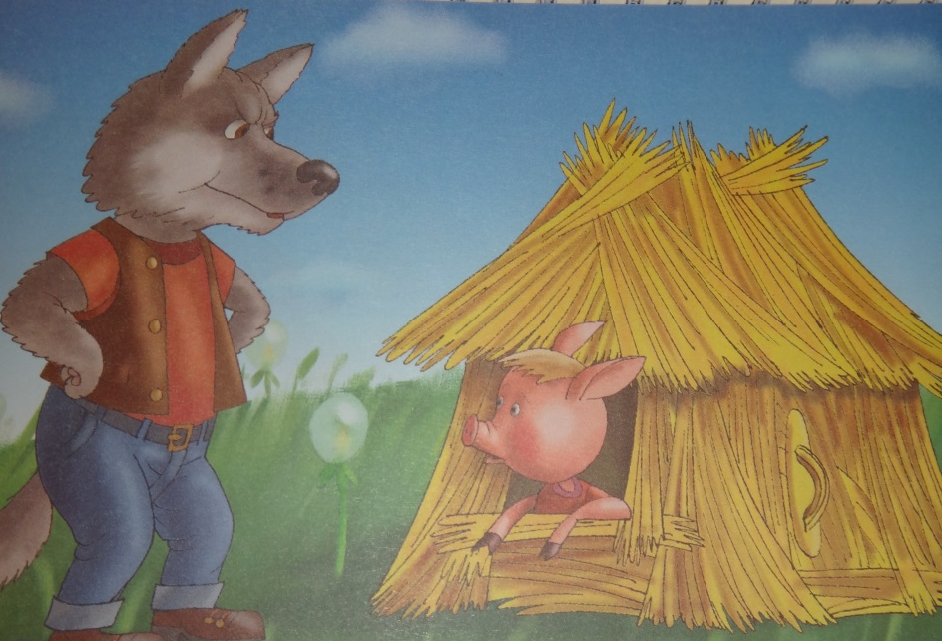
The first little pig builds a house of straw. The big bad wolf comes and says:
Little pig, little pig, let me come in!
- No. You are bad. You want to eat me!

Slide 4
The wolf is angry. He huffs, and puffs, and blows the house down. The little pig runs to his brother.

Slide 5
The second little pig builds a house of sticks. The big bad wolf comes and says: - Little pig, little pig, let me come in! - No, You are bad. You want to eat us!

Slide 6
The wolf is angry. He huffs, and puffs, and blows the house down. The two little pigs run to their brother.

Slide 7
The third little pig builds a house of bricks. The big bad wolf comes and says: - Little pig, little pig, let me come in! - No. You are bad. You want to eat us!

Slide 8
The wolf is angry. He huffs, and puffs, and huffs, and puffs, and huffs, and puffs. But he can not blow the house down.

Slide 9
The wolf is very angry. He wants to eat. He climbs on the roof and falls down the chimney.

Slide 10
The wolf is angry. He huffs, and puffs, and huffs, and puffs, and huffs, and puffs. But he can not blow the house down.

Slide 11
The wolf is angry. He huffs, and puffs, and huffs, and puffs, and huffs, and puffs. But he can not blow the house down. Разгадай кроссворд и ты узнаешь, где живет волк. 1. The bad wolf falls into the … and burns his tail. 2. The … is angry. 3.The first little pig builds a house of … 4. You are bad. You want to … me! 5. The second little pig builds a … 0f sticks. 6. These are the three … pigs.

