Slide 1
The Sleeping Beauty By Sharl Perro

Slide 2
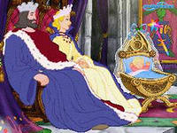
Once upon a time there was a King and a Queen who had all the luxury as that money could buy. But their most treasure possession of all was their beautiful baby daughter. In fact they were so proud of her that they invited all the fairies in the kingdom to her christening. It wasn’t every day that the fairies had a chance to get to such a grand occasion, so they made a most of it and made up the beautiful party dresses especially for it.The christening was such a happy and colourful occasion. The little Princess slept quietly in her cradle and didn’t make a sound. “I’ve never seen such a beautiful little baby,” said the queen of the fairies. When the Queen and the King heard this, it made their hearts swell with pride. “Thank you all so much for coming here,” said the King and then he led them all to the great banqueting hall for a fabulous feast in honour of his little Princess.
En

Slide 3
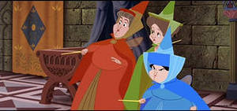
The fairies have just picked up their nice forks and they were about to start eating when they heard a terrible high pitched wailing sound coming from the end of the hall: “Stop!” They looked towards the grand staircase and saw an ugly old fairy storming down the stairs. She had a long pointed nose and was wearing an enormous black satin cloak.
En

Slide 4
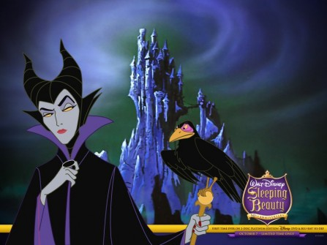
“Stop!” The old fairy looked straight at the Queen and said: “How can you have a party without inviting me? I am the oldest and the wisest fairy in the land!” The poor Queen was rather frightened of her but didn’t know what to say. “Leave it to me,” the King whispered. “Oh, look! I am terribly sorry with offended you but you are welcome to join in this celebrations,” he said in his kindest sweetest voice. “All right, I’ll stay if you insist, “ said the ugly fairy. But she still was not happy. “I’ll get my own back on my pair for forgetting to invite me!” she muttered to herself.
The wicked old fairy certainly took advantage of the King’s hospitality. She powered up her plate that they could hardly see her face behind a tall mount of food on it. The banquet lasted a long time because all the guests had to wait for the old fairy to finish eating. At last, when she did her final mouthful, everybody left the table and came up to stare gifts for the Princess.
En

Slide 5
Great beauty, a kind heart and a wonderful singing voice — were just a few of the gifts given to the lovely Princess. When it came the old fairy’s turn, she lent over the cradle and said: “You will prick your hand with a spindle and die of the wound.”
All the other fairies gasped at these terrible words. Then Christine, who was the youngest fairy, stepped forward:
“I can’t change the awful spell but I can alter it. You will indeed prick your finger but you will not die. Instead, you will fall into a deep sleep that will last for a hundred years until a handsome prince awakens you.
That night when all the guests had left, the King ordered that all the spinning wheels with the spindles in his Kingdom should be burnt. So his servants went on collecting all the spindle wheels in the land and burnt on a big bomb firing in the palace garden. All his subjects were sad to see spindle wheels going up in smoke but they didn’t complain. They knew this had to be done for the sake of the little Princess.
“I feel so much happier now when all the spindles left our kingdom,” said the King to his wife.
“You are very wise to be so careful,” said the Queen. “But what about our poor subjects? Many of them rely on their spinning means to only living.”
“Don’t worry! I’ve given a bag of gold to everybody who had burnt his spinning wheel,” said the King.
And these kind words made the Queen very happy. Many happy years passed. And the Princess grew up to be all the King and the Queen had hoped for: beautiful, clever and very kind. But one day the King and the Queen went on a royal tour and left the Princess to look after the palace. She felt very lonely without her mother and father. So she wandered around the palace looking for somebody to talk to.
En

Slide 6
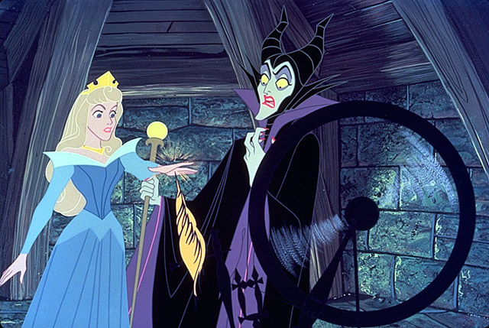
The only person she could find was an old woman who lived at the top of the palace. The old woman was very glad to see her as she was feeling very lonely too. “Do come into, here!” said the old woman. “I’ve just baked a cake. Please, take a slice and let me make you a cup of tea to go with it.” “That will be lonely!” said the Princess. And when the old woman within the kitchen making the tea, the Princess noticed a spinning wheel in the corner of the room.
“What a strange machine?” asked the Princess. “It’s a spinning wheel,” said the old woman in reply. “I’ll just put this thread down and now show you how it works. The old woman hadn’t heard about the King’s ban all these years ago and she didn’t think of making any harm in showing the Princess how to spin. So the old woman sat down at the wheel and started spinning. The Princess watched her with eager eyes. “I’d love to do it myself,” she said. But no sooner had she started spinning when she pricked her hand on a needle and fainted. “Help! Help! The Princess has fainted!” cried the old woman.
En

Slide 7
Servants came running from all corners of the palace. One servant threw a bucket of water over her while another held a jag of smelling salt under her nose. But nobody could make the Princess wake up.
“Fetch the royal doctor!” shouted the head servant.
And one of the young servants ran to tell him about the sleeping Princess. When the doctor arrived, he tried all sorts of things to wake her up. He even put an ear trumpet to her ear and shouted into it. But she still wouldn’t wake up.
Later that day the Queen and the King came back from their royal tour. They were very shocked when they found their beautiful daughter in the old woman’s room in such a deep sleep that she couldn’t wake up.
“You are a stupid old woman,” cried the King. “Didn’t you know that all spinning wheels were banned in my kingdom many years ago? You deserved to go to prison for this.”
The poor old woman couldn’t understand what she had done wrong.
“I’ve lived alone and haven’t seen your servants for many years, Your Majesty. And no one told me about a wicked spell,” was her reply.
“Don’t be too hard to the old woman,” said the Queen. “She is not to be blamed for our poor daughter’s fate.”
“Yes, you are right,” said the King. “It’s not her fault! Come and let’s take our daughter down and make her as comfortable as we can.”
En

Slide 8
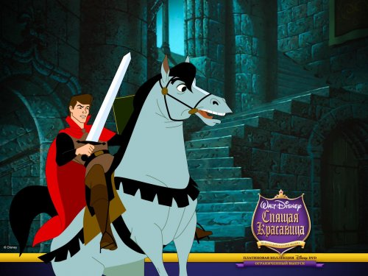
Then one day a handsome young Prince rode by. He noticed the towers of the palace sticking out above the bushes and being a curious lad, he got off his horse and stabbed a better look. The young Prince saw a man riding by on a horse and shouted out to him: “Do you know who lives in these towers over there?” “You’ll find witches and ghosts living there,” replied the man and he rode off. The Prince didn’t take his answer very seriously, so he decided to ask a farmer who was walking by the same question.
The good fairy Christine who had been at the christening soon found out about the Princess and she rushed over to the King and Queen’s palace in a golden chariot. She was a very clever fairy because she realized that if the Princess woke up in a hundred years time and found herself alone she would be very frightened. So the fairy waved a magic wand and put all the servants in the palace, and the King and the Queen, to sleep as well.
In just a few minutes a large number of thorny bushes and trees within intertwining branches grew up around the palace and it became impossible for anyone to get through.
A hundred years have passed while the ingested castle slept.
En

Slide 9
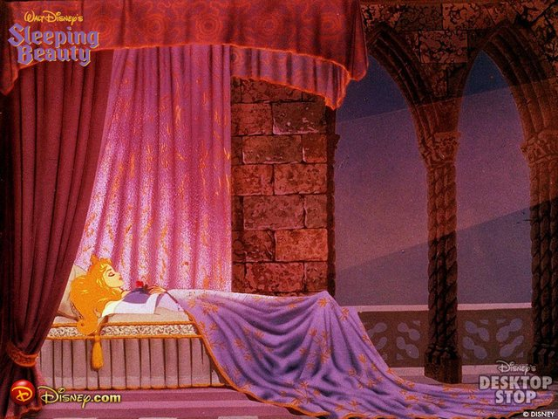
The farmer told him: “Many years ago a beautiful young princess lived here with the King and Queen, and as it is said that she was put under the spell that would make her sleep for a hundred years. I was told that she would only wake up when the most handsome prince in the land would kiss her. When he heard this, the Prince was so fascinated by this story that he rushed straight over through to the tangle woods and tried to cut his way through with his sward as he thought..
But there was no need for him to do this because every time he moved forward, the trees made a pass to let him pass through. When he entered the palace courtyard, he was amazed by what he saw. All the servants were asleep, some had even fallen asleep standing up. The Prince called out: “Hello? Anybody there?” But there was no reply. All the palace was absolutely quiet except for the occasional sound of snoring. He walked past all the servants thinking he might wake them up, but none of them did. He even tickled the couple of them but there was no response. Next he came up to the palace guard: they were all lying up in front of the grand staircase with muskets on their shoulders, but even they were fast asleep. Even though the Prince was a little nervous if just walking past, so he went very close to the ear of the sergeant in charge and shouted as loud as he could: “Wake up!”
En

Slide 10
Lying on the bed was the most beautiful girl that the Prince had ever seen. She was dressed in a magnificent gown, but like everyone else in the palace she was fast asleep. The Prince realized that this must be the Princess and she had been sleeping for a hundred years. “Hello,” he whispered. “I am the Prince who has come to break your spell.” And he kneeled the bed and kissed the Princess very gently. This was the very moment at which the wicked fairy spell was broken, and the Princess awoke. As she saw the Prince nearly at her bedside, she looked straight into his deep blue eyes and said: “I’ve waited for a long time for you, my Prince.” The Prince was charmed by these words and he quickly told the Princess that he had loved her as soon as he first saw her.
At the very same moment as the Princess had been woken up, everyone else in the palace had also been woken up from a deep sleep: the King and the Queen, all the servants, the palace guard and courtiers started busily about their business.
They were all delighted because they saw their beautiful young Princess had woken from her hundred years’ sleep. And it was clear that she was very happy with the handsome Prince. But those of them who were not in love were very hungry indeed.
En

Slide 11
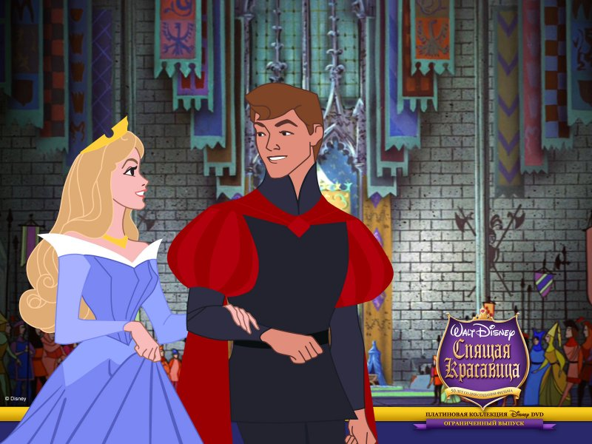
So a huge celebration banquet was prepared, and they all sat down in the grand hall to a hearty meal including the happy young Prince and Princess. While they were eating this grand meal, all the thorny bushes and trees with intertwining branches that had surrounded the palace for a hundred years disappeared. The Prince took the beautiful Princess home to his palace and introduced her to his parents, the king and the queen. They were very happy that the two were deeply in love. And the very next day the handsome Prince and the beautiful Princess were married at a grand ceremony. After the wedding ceremony everybody waved good-bye to the Prince and Princess as they set off to the far away land for their honeymoon.
En

Slide 12
QUIZ TIME
Answer the following questions.
1.The King and Queen were proud of their beautiful baby daughter, weren’t they?
2.The christening was a happy and colourful occasion, wasn’t it?
3.What did they all hear when they were about to start eating?
4.The King and Queen forgot to invite the wicked old fairy, didn’t they?
5.What was the wicked old fairy’s gift for the Princess?
6.The King ordered to burn all the spinning wheels in the kingdom.
7.What did the Princess notice in the corner of the old woman’s room one day?
8.What happened to the Princess when she started spinning?
9.Who made everybody in the palace sleep for a hundred years?
10.Who awoke the Princess from her long sleeping?
En

Slide 13
Choose the proper alternative to complete the following sentences according to the text: 1.The King and Queen were very happy and proud of their beloved __________. a)treasures b)baby daughter c)kingdom 2.The Queen was frightened of __________. a)the King b)the wicked old fairy c)Christine 3.The ____________ waved a magic wand and put everybody in the palace to sleep. a)Princess b)Christine c)wicked old fairy
En

Slide 14
Agree or disagree with the following statements according to the text. Correct the wrong ones: 1.The King and Queen loved their beautiful daughter most of all their treasures. 2.The Christening was a very happy and colourful occasion. 3.All the fairies of the kingdom were invited to the fabulous feast. 4.Nobody could alter the horrible spell. 5.When a girl the Princess could see a lot of spinning wheels around her. 6.The Princess could spin very well. 7.Three hundred years has passed when the Princess fell into a long sleep. 8.After the wedding ceremony the Princess slept again.
En

